Slide 1
Solar Thermal Energy

Slide 2
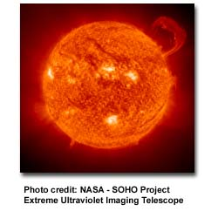
Introduction
We have always used the energy of the sun as far back as humans have existed on this planet. We know today that the sun is simply our nearest star and without it, life would not exist on our planet. We use the sun’s energy everyday in many different ways.
In Belize we hang our clothes out in the sun to dry, for drying fish, fruits, etc.

Slide 3
Introduction
Decaying plants hundreds of millions of years ago produced the coal, oil and natural gas that we use today. So, fossil fuels is actually sunlight stored millions and millions of years ago.
Indirectly, the sun and other stars are responsible for ALL our energy. Even nuclear energy in the fury of a nova – a star exploding.

Slide 4
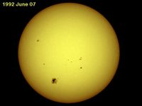
Solar Thermal Energy
There are many applications for the direct use of solar thermal energy, space heating and cooling, water heating, crop drying and solar cooking.
The most common use for solar thermal technology is for domestic water heating.
The Mediterranean and Australia – high solar insulation.

Slide 5
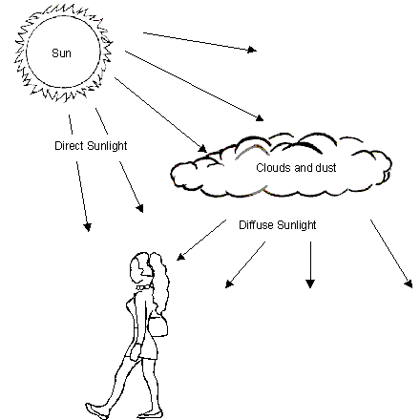
The nature and availability of solar radiation

Slide 6
A passive solar desalination system uses the sun's energy to heat saline water, causing evaporation and then condensation of the water vapor to produce fresh water, mimicking the natural water cycle.
These systems require no external electricity, operating through natural processes like gravity, pressure, and convection, and often feature designs like solar stills or layered, wick-free structures that prevent salt buildup and improve efficiency.
Recent advancements aim to increase water production rates, improve solar-to-water efficiency, and enable continuous operation, making them promising for off-grid communities in arid coastal regions

Slide 7
How it Works
Solar Heating: The system absorbs solar radiation, heating a layer of saltwater.
Evaporation: As the water heats, it turns into water vapor, leaving the salt behind.
Condensation: The water vapor rises, contacts a cooler surface, and condenses back into liquid fresh water.
Collection: The condensed fresh water drips or flows into a separate collection channel.

Slide 8
Key Features & Innovations
Wick-Free Designs:
Some modern systems eliminate the need for traditional wicks, using layered structures with convection to draw salt back into the main body of water and prevent clogging.
Natural Circulation:
Convection currents driven by temperature differences and gravity move water and salt within the device, improving salt rejection and the efficiency of the evaporation process.
Thin-Film Condensation:
Novel modes of condensation on thin films are being developed to enhance the overall solar-to-water efficiency and water production.
.

Slide 9
Improved Salt Rejection:
New designs prevent the salt from crystallizing and building up on the evaporator, which can limit the operating time of simpler systems.
Floating Systems:
Some designs are engineered to float on the surface of the water, reducing the need for costly grounded structures and potentially serving a wider range of bodies of water

Slide 10
Benefits
Low Cost & Accessibility:
These systems use inexpensive materials and require no grid electricity, making them ideal for rural and off-grid areas.
Sustainability:
They utilize abundant solar energy, providing a renewable and environmentally friendly source of fresh water.
Reliability:
Passive systems are inherently reliable due to the absence of complex, power-dependent components.

Slide 11
Challenges & Future Outlook
Low Water Output:
Historically, passive solar desalination has been limited by its low water production rates compared to active systems.
Efficiency Improvements:
Research is focused on improving the solar-to-water efficiency through optimized thermal design and enhanced heat and mass transfer within the device.
Scaling Up:
Bridging the gap between laboratory innovations and large-scale commercial deployment is a significant challenge for widespread adoption.
Reliability & Anti-Fouling:
Developing robust, anti-fouling systems capable of continuous operation under real-world conditions is crucial for long-term success.

Slide 12
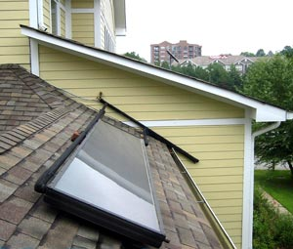
How does solar thermal work?
Have you ever felt warm water trickle out of a garden hose that’s been sitting in the sun? If so, then you’ve witnessed solar water heating in action.

Slide 13
Solar thermal designs
There are a number of different solar thermal designs, but all are based on the same principle as the garden hose. Each has its pros and cons and each is suitable for a specific application.

Slide 14
Different types of systems
Passive and active
The terms passive and active in solar thermal systems refer to whether the systems rely on pumps or only thermodynamics to circulate water through the systems.

Slide 15
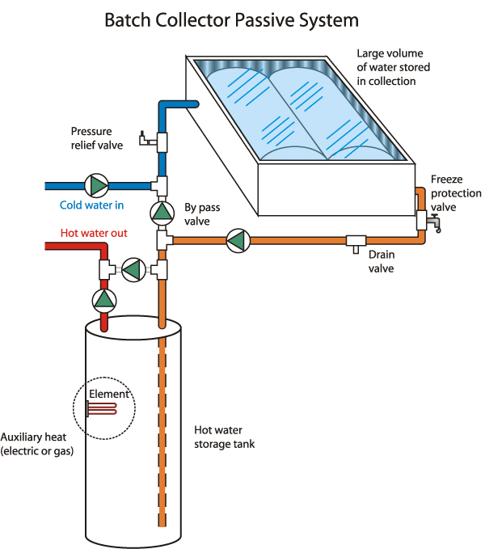
Passive

Slide 16
Types of Passive systems
Conservatory or ‘sunspace’
A conservatory or greenhouse on the south side of a building can be thought of as a kind of habitable solar collector. Air is the heat transfer fluid, carrying energy into the building behind. The energy store is the building itself, especially the wall at the back of the conservatory.
Trombe Wall

Slide 17
Direct Gain
The simplest and most common of all passive solar heating systems. The sun’s rays penetrate the windows and are absorbed into the interior.

Slide 18
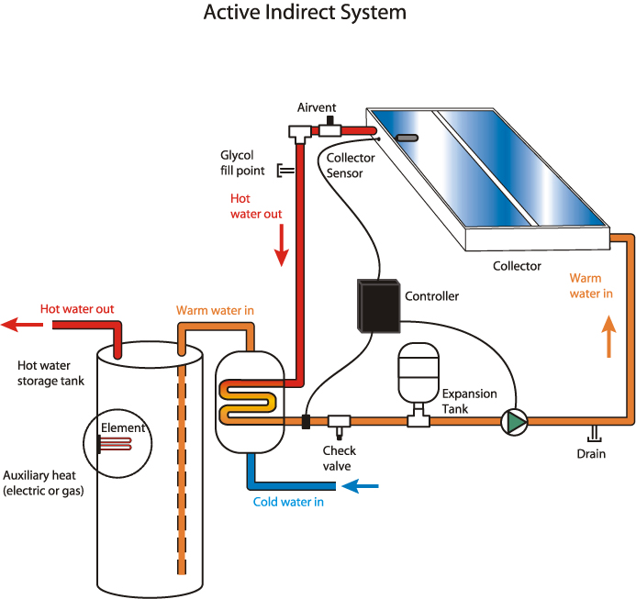
Active

Slide 19
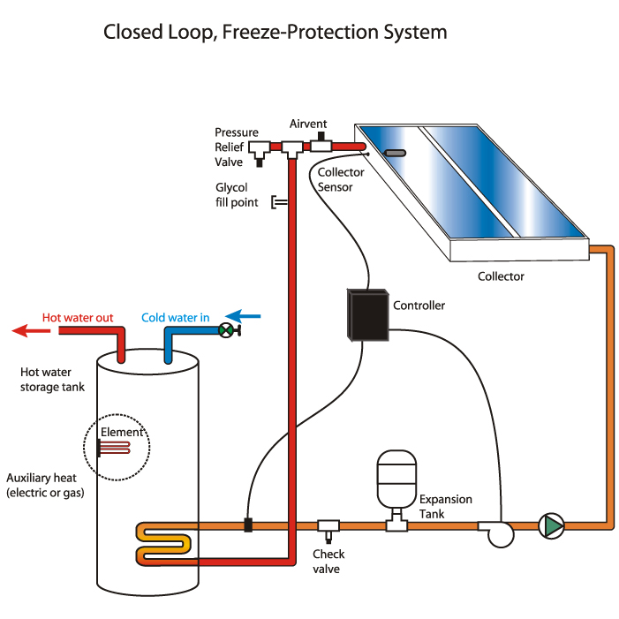
Indirect System

Slide 20
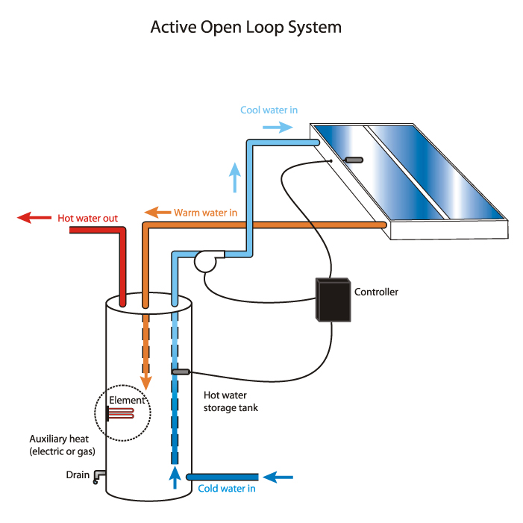
Direct System

Slide 21
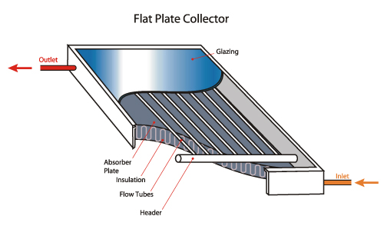
Collecting the sun
Solar thermal systems also differ by the type of collector used to gather and store the sun’s energy.

Slide 22
Solar cooking
This technology has been given a lot of attention in recent years in developing countries. The basic design is that of a box with a glass cover. The box is lined with insulation and a reflective surface is applied to concentrate the heat onto the pots. The pots can be painted black to help with heat absorption. The solar radiation raises the temperature sufficiently to boil the contents in the pots.

Slide 23
Space heating
Certain guidelines that should be followed:
A building should have large areas of glazing facing the sun to maximize solar gain.
Features should be included to regulate heat intake to prevent overheating.
A building should be of sufficient mass to allow heat storage for the required period.
Contain features which promote the even distribution of heat throughout the building.

Slide 24
Trombe wall
A massive black painted wall that has a double glazed skin to prevent captured heat from escaping. The wall is vented to allow the warm air to enter the room at high level and cool air to enter the cavity between the wall and the glazing. Heat stored during the day is radiated into the room during the night.

Slide 25
Daylighting
A simple and obvious use for solar energy is to provide light for use in buildings. Many modern buildings, office blocks and commercial premises are designed in such a way that electric light has to be provided during the daytime to provide sufficient light. An obvious improvement would be to design building in such a way that the light of the sun can be used for this purpose.

Slide 26
Several researchers have experimented with various design parameters on solar stills to optimize the distillate.
It has been observed that various design/operating parameters affect productivity and efficiency such as angle of solar radiation, angle of inclination, cover plate transmissivity, depth of water, wind velocity, basin surface absorptivity, flow rate, convective heat transfer coefficient, insulation of wall of basin, and so on.
These parameters help to modify and design solar desalination to be more productive. The present study refers to the evaluation of various design parameters for simple solar stills impacting yielding rate and heat transmission characteristics.
The observations for the utility indicators and performance comparisons of several solar stills have been mentioned along with the significant interpretations, and finally, recommendations for future improvement of the novel concepts were also made in the proposed work.

Slide 27
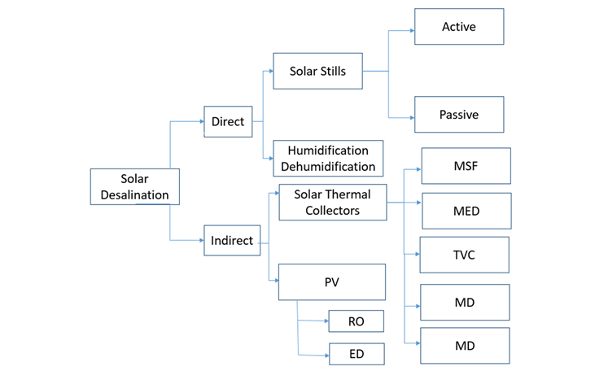

Slide 28
ADVANTAGES OF SOLAR DESALINATION
Low Operating Costs:
After the initial setup, solar energy is free, resulting in significantly lower operational costs compared to conventional systems that rely on paid energy sources.
Renewable Energy Source:
Solar energy is a clean, renewable resource, which minimizes the reliance on fossil fuels and reduces the system's carbon footprint and environmental impact.
Environmental Benefits:
By using solar power, these systems reduce air pollution and greenhouse gas emissions associated with other energy-intensive desalination methods.
Independent and Reliable Water Supply:
Solar desalination is particularly beneficial for remote areas and small islands, providing an independent and reliable source of freshwater where grid-based power may be unavailable or unreliable.
Simple Design and Maintenance:
Simple solar distillers can be easy to design, install, and operate, and their passive nature often requires less complex infrastructure and lower maintenance.

Slide 29
DISADVANTAGES OF SOLAR DESALINATION
High Upfront Costs:
The initial capital investment for purchasing and setting up solar desalination equipment can be high.
Low Water Production Volume:
Simple solar distillation systems, while low-cost to operate, typically have a limited water production capacity per unit area.
Large Land Occupancy:
For passive solar distillers, a significant amount of space is required to achieve a substantial daily output of freshwater.
Dependence on Solar Radiation:
The system's efficiency and water output are directly dependent on the availability and intensity of solar radiation, meaning performance can vary significantly with different climates and weather conditions.
Intermittent Nature:
Solar energy is intermittent, which means that the system may not operate continuously, especially in areas with short daylight hours or cloudy weather.

Slide 30
Advantages of using solar power for water treatment systems
Off-grid capabilities allow for remote installation
Lower operating costs compared with fossil fuel powered systems
Reduced maintenance costs
Localised power generation (reduced transmission lines)
High solar irradiation near equator reduces solar array footprint
Disadvantages of using solar power for water treatment systems
Reduced output during cloudy days
Higher capital costs compared with fossil fuel powered systems
Fewer operating hours per day than fossil fuel powered systems
Water treatment system will have larger hourly capacity to achieve required daily production
Low solar irradiation further from equator increases solar array footprint

Slide 31
OBSERVATION OF ENHANCED PARAMETERS FOR CONVENTIONAL SOLAR STILL
Murugavel et al. (2010),Although it operates similarly to single-slope solar stills (SSSS), a double-slope solar still (DSSS) has two glasses to cover the top that increase the condensation surface area for condensation of the rising vapor inside the still. The DSCSS has a more productive rate of fresh water with effective condensation, as shown in Figure 2
The double slope of the cover plate explores more surface area on a specific inclination to be more efficient. Condensation on the cover surface is enhanced with a large surface area.

Slide 32
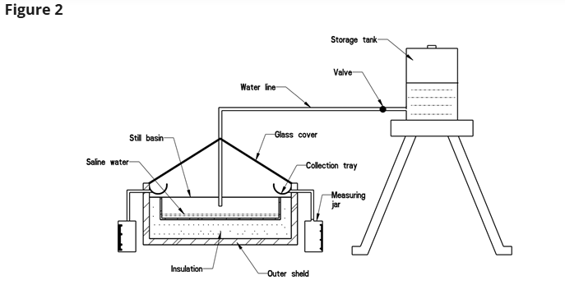
Double-slope collector solar still

Slide 33
Designed a double-slope solar still with an outer surface of mild steel and observed the performance of the system with a level of water and various heat-sensible storage materials, including quartzite rock, concrete cement pieces, red brick-washed stones, and iron scraps. They concluded that the basin material was quartzite rock that was still only an inch thick. Additionally, the temperature of the glass and water as well as the production rate was negatively impacted by the still's capacity and materials. In Ghaziabad, India (2840° N, 7725° E).
https://iwaponline.com/aqua/article/73/2/239/100032/Impact-of-various-design-parameters-on-solar-still

Slide 34
A solar desalination system with a basin top cover in the shape of a pyramid is referred to as a pyramid collector solar water still. In comparison to classic type stills, it still has a larger evaporation surface for the same basin area, increasing the productivity of the particular still.
The pyramid collector solar still (PCSS) may be improved by altering the height, orientation angle, and other particulars of the pyramid still's top cover. As seen in Figure 3, Kabeel (2009) carried out an experiment using a PCSS concave simply wick still. It can collect more solar thermal energy and produce more reflections since it has a larger surface area.
The still basin had a basin area of 1.2 × 1.2 m², a water depth of 10 cm, and a top glass cover that was angled at a 45° angle. Because it produces a thin layer of water for evaporation, which results in more evaporation and better yielding condensation, concave jute wick achieved better results than simple PCSS.

Slide 35
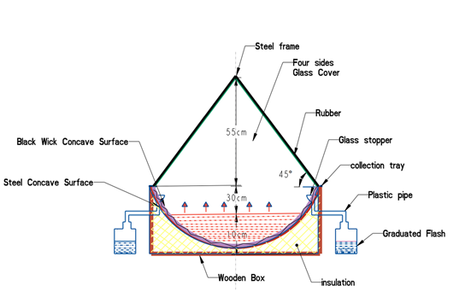
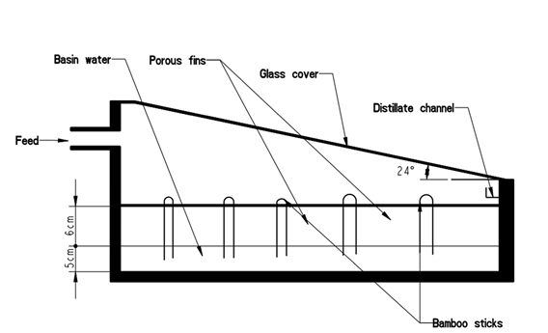
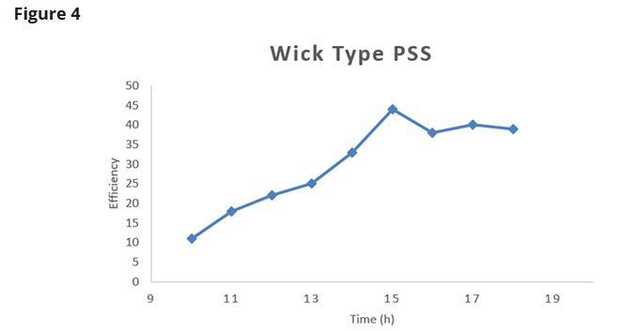
Pyramid collector solar water still
Modified still using porous absorber

Slide 36
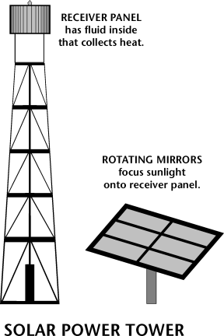
Solar thermal power stations
Two types:
Power tower
Sources: Energy Information Administration, Electric Power Annual, Form EIA-860, Annual Electric Generator Report database, 2004.

Slide 37
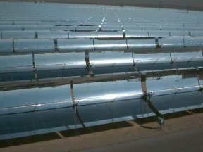
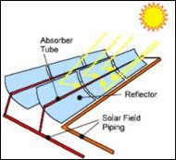
Parabolic trough
Sources: Energy Information Administration, Electric Power Annual, Form EIA-860, Annual Electric Generator Report database, 2004.

Slide 38
Other Uses
There are many other uses for solar thermal technology. These include refrigeration, air conditioning, solar stills and desalination of salt water and more.

Slide 39
PURPOSE OF SOLAR REFLECTORS
Concentrate Sunlight:
Reflectors are used to gather and direct additional solar radiation onto the solar still's absorber plate, which heats the saltwater.
Increase Efficiency:
By enhancing the amount of solar energy reaching the absorption area, reflectors significantly improve the thermal efficiency and freshwater production of the desalination unit.
Boost Distillate Output:
Experiments have shown that the integration of reflectors can lead to substantial increases in the daily amount of fresh water produced compared to systems without them.

Slide 40
TYPES AND CONFIGURATIONS
Internal Reflectors:
These are integrated within the solar still itself and are particularly useful for concentrating weak sunlight or in areas with low ambient temperatures.
External Reflectors:
Mounted outside the solar still, these reflectors redirect solar beams and can improve the design flexibility of the absorber plate configuration.
Reflector Shapes:
Different shapes, such as vertical flat plates and parabolic mirrors, are used to concentrate sunlight effectively.

Slide 41
MATERIALS
Mirrored Surfaces:
High-specular-reflection surfaces like glass mirrors or anodized aluminum sheets are commonly used due to their ability to reflect light efficiently.
Layered Reflectors:
These are typically made of a highly reflective metal (like aluminum) deposited on a substrate and protected by coatings, with configurations classified as first-surface or second-surface reflectors.
Benefits
Higher Freshwater Productivity:
Reflectors contribute to higher output, making solar desalination a more viable option in water-scarce regions.
Improved Efficiency:
The enhanced absorption of solar radiation leads to better overall system efficiency and a higher recovery ratio.
Economic Viability:
Increased productivity can reduce the cost per liter of distilled water, making the technology more economically feasible.

Slide 42
EVACUATED TUBE COLLECTOR
The evacuated tube collector (ETC) consists of a number of sealed glass tubes which have a thermally conductive copper rod or pipe inside allowing for much high thermal efficiency and working temperature compared to the flat plate solar collectors even during a freezing cold day.
While this type of solar hot water systems is cheap and easy to install, the problem with flat plate collectors is that they are “flat”.
This produces one limitation to their efficiency as they can only operate at maximum efficiency when the sun is directly overhead at midday. At other times, the sun’s rays are striking the collector at varying angles bouncing off the glazing material thereby reducing their efficiency

Slide 43
EVACUATED TUBE COLLECTORS
In solar desalination, Evacuated Tube Collectors (ETCs) are used to efficiently capture and transfer solar energy to the water, increasing its temperature and accelerating the evaporation process to produce freshwater.
ETCs work by creating a vacuum within dual glass tubes to act as an insulator, minimizing heat loss and improving efficiency, especially in cold or cloudy weather.
This collected thermal energy then heats the water for distillation or directly generates steam for multi-stage evaporation systems, ultimately boosting the overall freshwater yield of the solar desalination plant.

Slide 44
How Evacuated Tube Collectors Work in Desalination
Solar Energy Absorption:
The outer glass tubes of the ETCs absorb solar radiation.
Heat Transfer:
Inside the tubes, aluminum fins and a heat pipe transfer the absorbed solar energy into thermal energy.
Vacuum Insulation:
A vacuum created within the glass tubes acts as a highly effective insulator, reducing heat loss to the surroundings.
Heat Application:
The heat is then transferred to a working fluid, which can be water for direct heating or to create steam for the desalination process.

Slide 45
BENEFITS OF ETCS IN SOLAR DESALINATION
High Efficiency:
The vacuum-sealed design minimizes heat loss, resulting in higher efficiency compared to other solar collectors.
Improved Performance in Diverse Weather:
ETCs perform well even in cold or cloudy conditions because the vacuum allows for better heat retention.
Enhanced Evaporation:
The increased thermal energy generated by ETCs accelerates the evaporation process in the solar still.
Increased Freshwater Yield:
By effectively harvesting solar energy, ETCs lead to a higher rate of vaporization and thus increased freshwater production.
Cost Savings:
Some ETC designs are low-cost and do not require additional solar concentrators, making the desalination system more economical.

Slide 46
EVACUATED TUBE COLLECTORS
Solar hot water systems that use Evacuated Tube Collectors as their heat source overcome this problem because the solar collector uses individual rounded tubes which are always perpendicular to the sun’s rays for most of the day. This allows a solar hot water system using an evacuated tube collector to operate at a much high efficiency and temperature for a much longer period than a conventional single flat plate collector installed system.
Also, another advantage of solar evacuated tube technology is that the weight and roof structural problems caused by standard flat plate systems are eliminated as the solar tubes are not filled with large amounts of heavy water.
The Evacuated tube collector consists of a number of rows of parallel transparent glass tubes connected to a header pipe and which are used in place of the blackened heat absorbing plate we saw in the previous flat plate collector.
These glass tubes are cylindrical in shape. Therefore, the angle of the sunlight is always perpendicular to the heat absorbing tubes which enables these collectors to perform well even when sunlight is low such as when it is early in the morning or late in the afternoon, or when shaded by clouds. Evacuated tube collectors are particularly useful in areas with cold, cloudy wintry weathers

Slide 47
WORKING OF EVACUATED TUBE COLLECTORS
So how do solar evacuated tube collectors work?. Evacuated tube collectors are made up of a single or multiple rows of parallel, transparent glass tubes supported on a frame. Each individual tube varies in diameter from between 1" (25mm) to 3" (75mm) and between 5′ (1500mm) to 8′ (2400mm) in length depending upon the manufacturer.
Each tube consists of a thick glass outer tube and a thinner glass inner tube, (called a “twin-glass tube”) or a “thermos-flask tube” which is covered with a special coating that absorbs solar energy but inhibits heat loss. The tubes are made of borosilicate or soda lime glass, which is strong, resistant to high temperatures and has a high transmittance for solar irradiation.
Unlike flat panel collectors, evacuated tube collectors do not heat the water directly within the tubes. Instead, air is removed or evacuated from the space between the two tubes, forming a vacuum (hence the name evacuated tubes).

Slide 48
This vacuum acts as an insulator reducing any heat loss significantly to the surrounding atmosphere either through convection or radiation making the collector much more efficient than the internal insulating that flat plate collectors have to offer. With the assistance of this vacuum, evacuated tube collectors generally produce higher fluid temperatures than they’re flat plate counterparts so may become very hot in summer

Slide 49
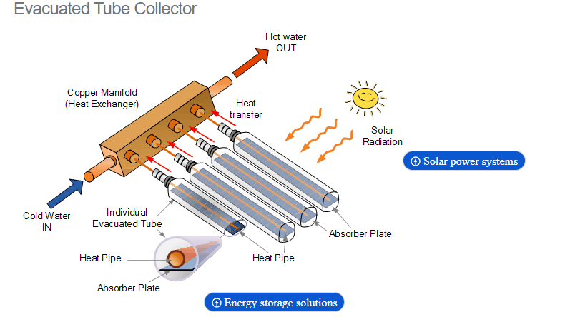
EVACUATED TUBE COLLECTOR

Slide 50
Inside the each glass tube, a flat or curved aluminium or copper fin is attached to a metal heat pipe running through the inner tube. The fin is covered with a selective coating that transfers heat to the fluid that is circulating through the pipe. This sealed copper heat pipe transfers the solar heat via convection of its internal heat transfer fluid to a “hot bulb” that indirectly heats a copper manifold within the header tank.
These copper pipes are all connected to a common manifold which is then connected to a storage tank, thus heating the hot water during the day. The hot water can then be used at night or the next day due to the insulating properties of the tank.
The insulation properties of the vacuum are so good that while the inner tube may be as high as 150ºC, the outer tube is cooler to touch. This means that evacuated tube water heaters can perform well and can heat water to fairly high temperatures even in cold weather when flat plate collectors perform poorly due to heat loss

Slide 51
However, the downside of using evacuated tubes is that the panel can be a lot more expensive compared to standard flat plate collectors or solar batch collectors. Evacuated tube solar collectors are well suited to commercial and industrial hot water heating applications and can be an effective alternative to flat plate collectors for domestic space heating, especially in areas where it is often cloudy.
Evacuated tube collectors are overall more modern and more efficient compared to the standard flat plate collectors as they can extract the heat out of the air on a humid, dull overcast days and do not need direct sunlight to operate. Due to the vacuum inside the glass tube, the total efficiency in all areas is higher and there is a better performance even when the sun is not at an optimum angle.
For these types of solar hot water panels, the configuration of the vacuum tube is what’s really important. There are a few different vacuum tube configurations, single wall tube, double wall tube, direct flow or heat pipe, and these differences can determine how the fluid is circulated around the solar hot water panel.

Slide 52
References
http://southface.org/solar/solar-roadmap/solar_how-to/solar-how_solar_works.htm
Boyle, Jeoffery, Renewable Energy
Practical Action, The Schumacher Center for Technology and Development

Slide 53
Thank you!!!!

Slide 54
Solar reflectors in a solar desalination system focus and redirect sunlight to the evaporation unit, thereby increasing solar radiation absorption and boosting freshwater production.
These reflectors can be internal, located within the solar still to concentrate sunlight on the absorber plate, or external, mounted around the unit to capture and direct more solar energy onto the evaporation area.
Common materials for reflectors include glass, anodized aluminum, and mirrors, with designs ranging from simple flat plates to parabolic shapes, all aimed at enhancing system efficiency and daily distillate output

Slide 55
ENERGY EFFICIENCY OF NANO FILTRATION
Energy efficiency of Nano filtration, emerging technologies for desalination will be considered.
Nano filtration is more energy-efficient than reverse osmosis (RO) in desalination because its lower operating pressures require less energy, leading to significant energy savings and lower costs. Emerging desalination technologies focus on further improving energy efficiency through renewable energy integration and advanced membrane designs, while novel processes like electrodialysis (ED) and forward osmosis (FO) also offer potential energy benefits, particularly for brackish water and in hybrid systems.

Slide 56
ENERGY EFFICIENCY OF NANOFILTRATION (NF)
Lower Operating Pressures:
NF membranes operate at lower pressures compared to RO, which directly translates to reduced energy consumption.
Selective Ion Separation:
By allowing monovalent ions to pass while rejecting multivalent ions, NF processes are inherently more energy-efficient than systems that must remove all ions, like RO.
Reduced Costs:
Lower energy needs result in a more cost-effective desalinated water production, making NF a financially attractive option, especially in areas with high energy costs.

Slide 57
EMERGING TECHNOLOGIES AND ENERGY EFFICIENCY
Renewable Energy Integration:
Integrating renewable sources such as solar thermal, solar PV, wind, and geothermal power with thermal desalination plants helps reduce greenhouse gas emissions and overall energy consumption.
Hybrid Systems:
Combining different technologies, such as membranes with renewable energy sources, can create more energy-efficient desalination processes for various water types.
Advanced Membranes:
Research and development of innovative NF membranes are focused on improving flux, selectivity, and fouling resistance, further reducing energy consumption by operating under more efficient conditions.
Green Hydrogen Production:
The use of green hydrogen, produced via water electrolysis powered by renewable energy, highlights the need for efficient desalination to supply ultrapure water for electrolyzers, driving further innovation in this area.
Other Emerging Technologies:
Technologies like electrodialysis (ED) and forward osmosis (FO) are also being developed for their energy-saving potential, particularly for brackish water desalination and in conjunction with other processes

